Slide 1
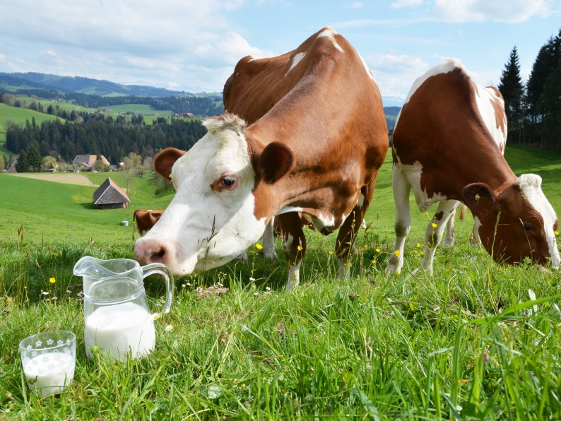
Congenital Lactase Deficiency
Hayley Stoneman

Slide 2
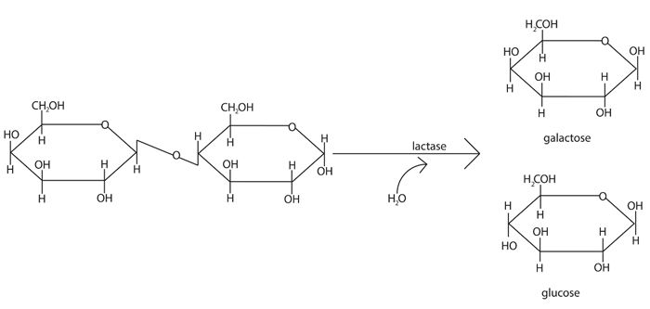
What is congenital lactase deficiency (CLD)?
CLD patients cannot digest lactose, resulting in diarrhea

Slide 3
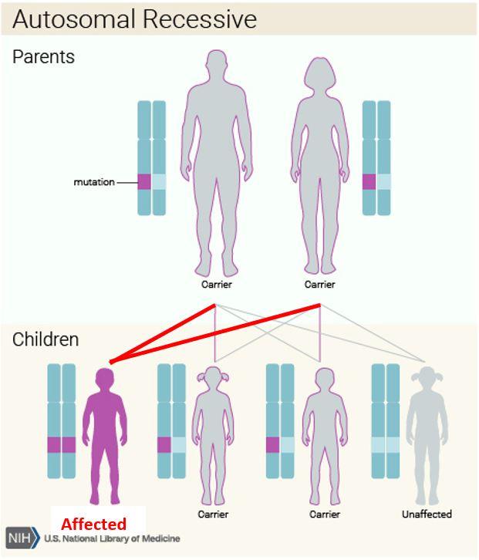
How is CLD inherited?
CLD is an autosomal recessive disease

Slide 4
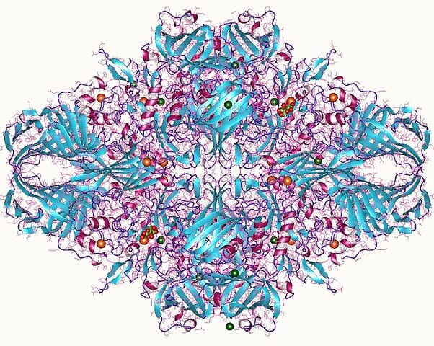
What gene is associated with CLD?
Mutations in the gene LCT, which encodes lactase, cause CLD

Slide 5
What are the LCT protein domains?
Signal sequence
Transmembrane region
Glycosyl-
Hydrolase
Family 1
Glycosyl-
Hydrolase
Family 1
Glycosyl-
Hydrolase
Family 1
Glycosyl-
Hydrolase
Family 1
Glycosyl-hydrolase family 1 breaks O-glycosyl bonds

Slide 6
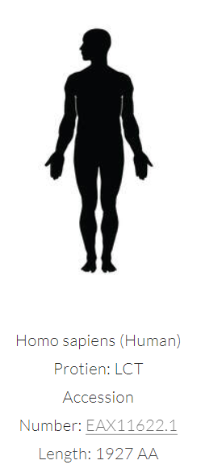
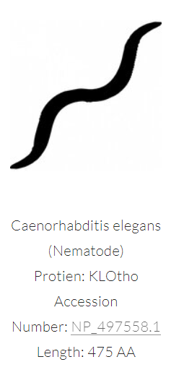
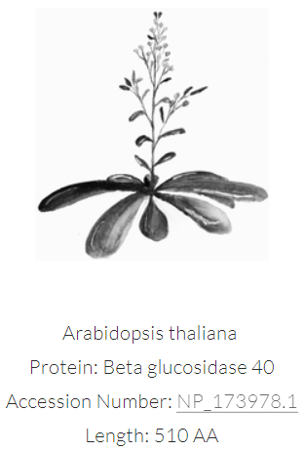
How well is LCT conserved?
All homologs have glycosyl-hydrolase family 1 domains

Slide 7
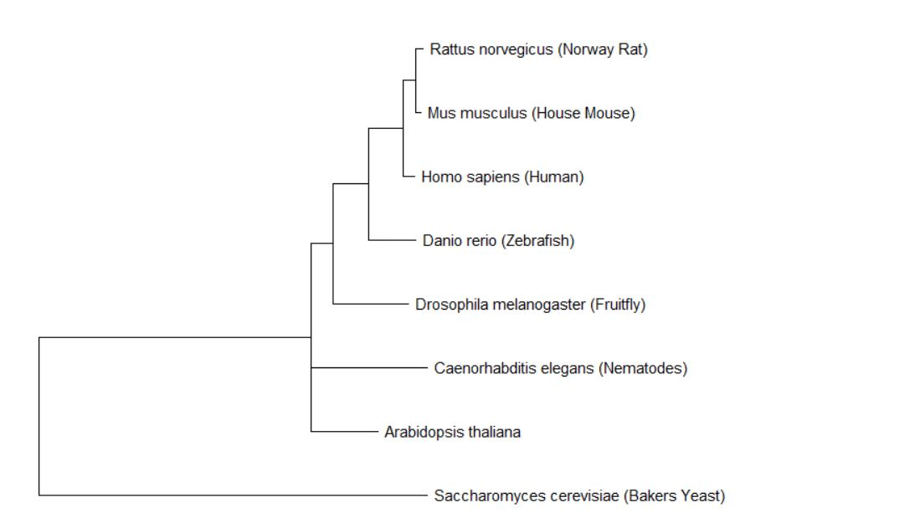
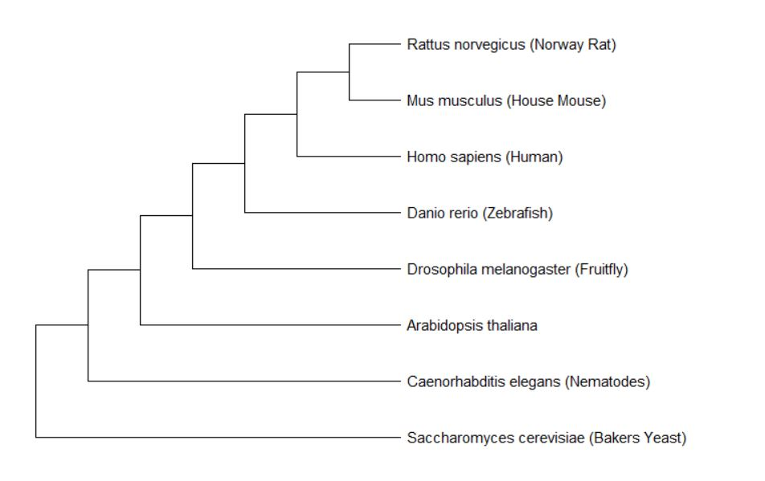
What is LCT phylogeny?
Maximum Likelihood Tree
Neighbor Joining Tree
Milk-consuming animals have closest related LCT proteins

Slide 8
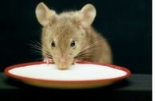
What model organism should be used to study CLD?
Mouse diet is easily manipulated and diarrhea is easily observed

Slide 9
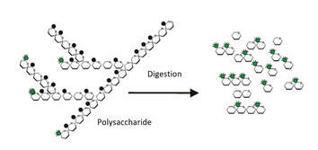
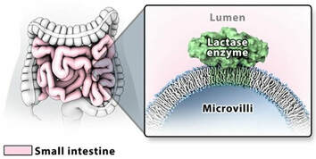
What are the GO terms of LCT?
Biological Process polysaccharide digestion
Molecular Function lactase activity
Cellular Component cellular membrane of intestinal track

Slide 10
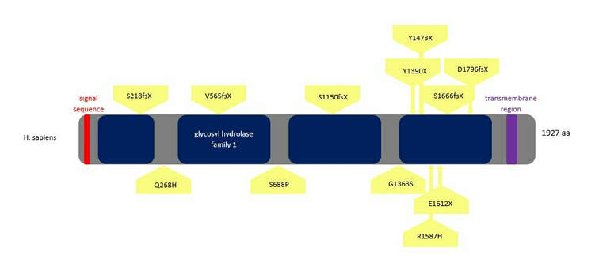
What domains do CLD mutations affect?
Many mutations affect C-terminal glycosyl hydrolase domain

Slide 11
What is the gap in knowledge?
?
Unknown how R1587H causes loss of functional lactase and CLD

Slide 12
What is the primary goal?
To understand how a single amino acid substitution, R1587H, affects the structure, function, and interaction of LCT to determine how it leads to CLD
Aim 1
Understand the evolutionary history of LCT and conservation of the C-terminus and R1587
Aim 2
Determine differentially expressed genes and their functions in R1587H mutant mice
Aim 3
Experimentally determine protein-protein interactions of WT and R1587H mutant mice LCT

Slide 13
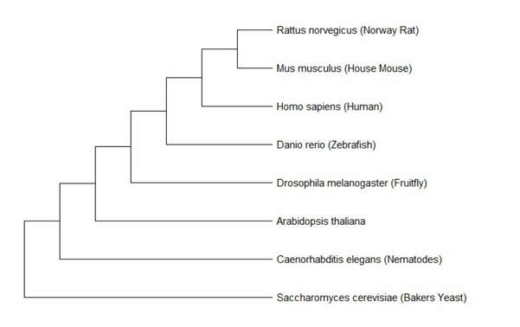
Aim 1: Understand evolutionary history of LCT and conservation of R1587 and the C-terminus
Approach: Use amino acid sequence to build phylogenetic trees and observe conserved regions

Slide 14
Aim 1: Understand evolutionary history of LCT and conservation of R1587 and the C-terminus
?
Rationale: Evolutionary history can elucidate the importance of R1587 in functional lactase among milk consuming organisms

Slide 15
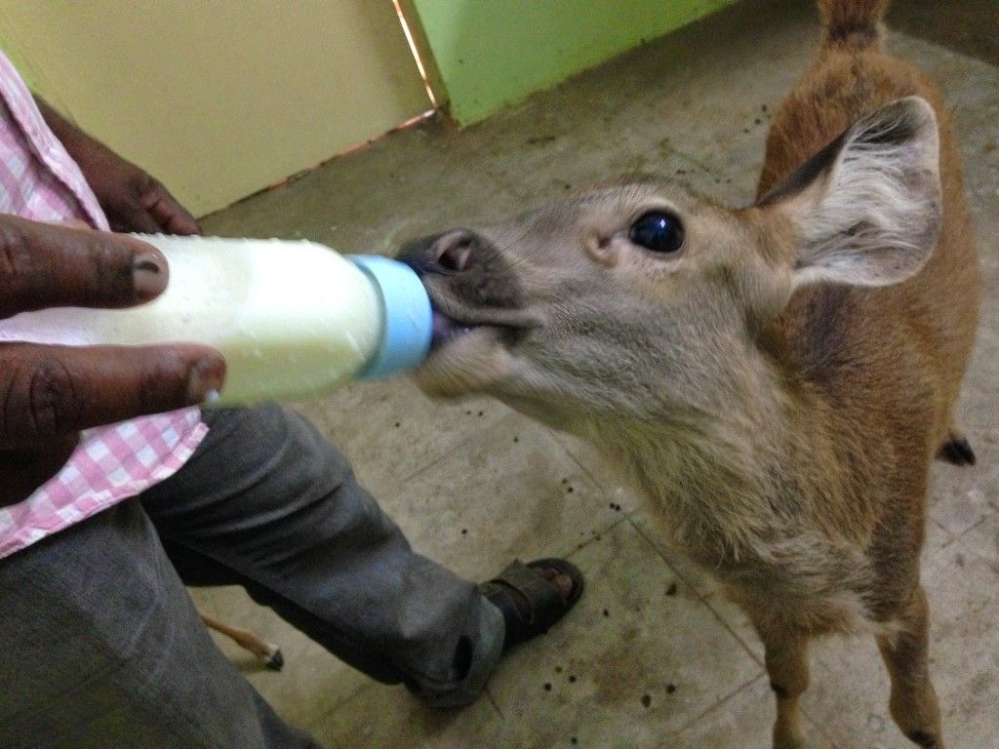
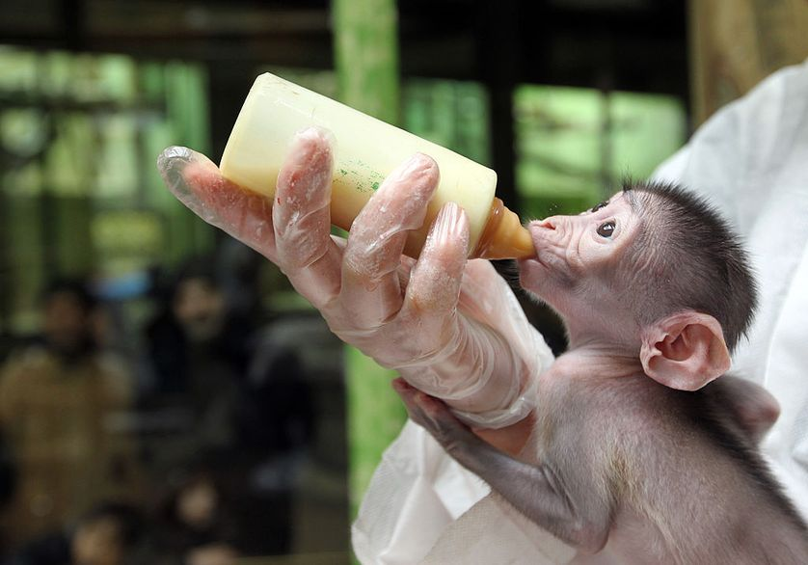
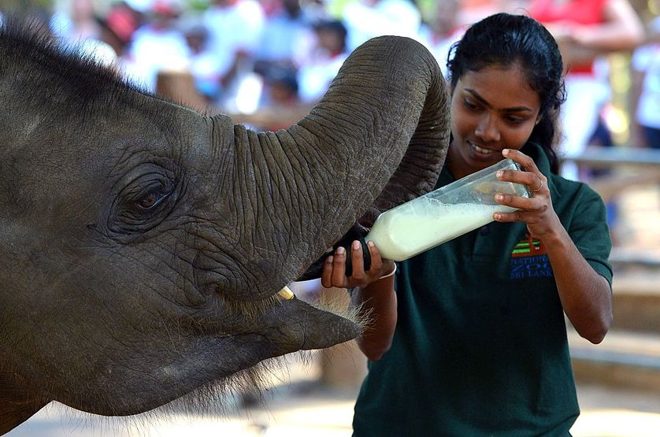
Aim 1: Understand evolutionary history of LCT and conservation of R1587 and the C-terminus
Hypothesis: R1587 will be conserved among milk consuming organisms

Slide 16
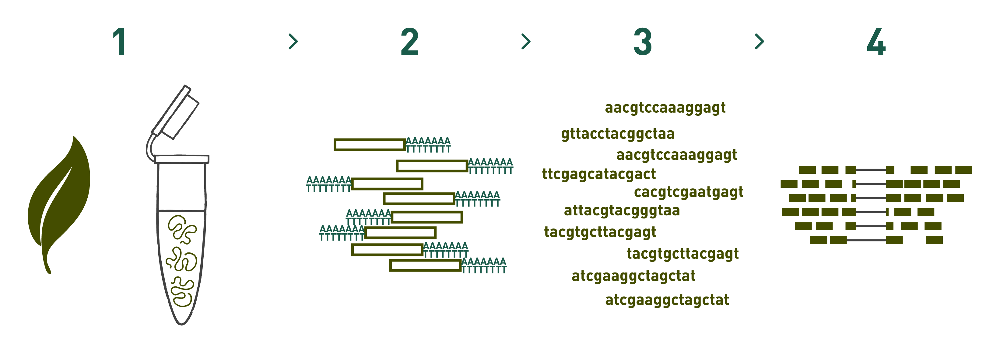
Aim 2: Determine differentially expressed genes and their functions in R1587H mutant mice
R1587H
Diarrhea
Approach: Create mutant mouse line and confirm CLD phenotype, then perform RNA-seq to identify gene expression

Slide 17
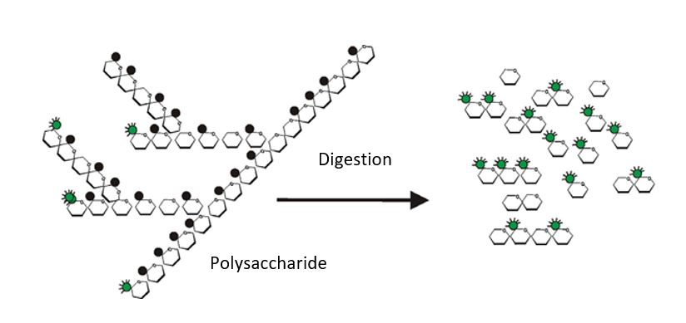
Aim 2: Determine differentially expressed genes and their functions in R1587H mutant mice
?
Rationale: Determining differentially expressed genes will elucidate interrupted biological processes

Slide 18
Aim 2: Determine differentially expressed genes and their functions in R1587H mutant mice
R1587H
Excretory function
Polysaccharide digestion
Polysaccharide transport
Hypothesis: R1587H mice will have differentially expressed genes related to excretory function and polysaccharide digestion/transport

Slide 19
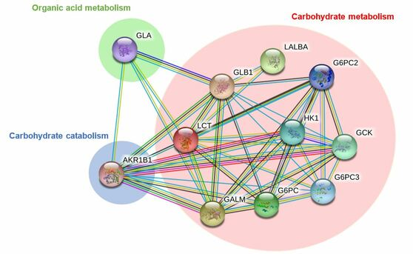
Aim 3: Experimentally determine protein-protein interactions of WT and R1587H LCT
gene
Approach: Use mammalian two-hybrid system to identify protein-protein interactions and sort according to GO terms

Slide 20
Aim 3: Experimentally determine protein-protein interactions of WT and R1587H LCT
?
Rationale: Create first experimentally determined interaction network for LCT and determine which protein-protein interactions inhibited by R1587H

Slide 21
Aim 3: Experimentally determine protein-protein interactions of WT and R1587H LCT
Hypothesis: Interaction network will involve carbohydrate metabolism proteins and R1587H will interrupt many of these interactions

Slide 22
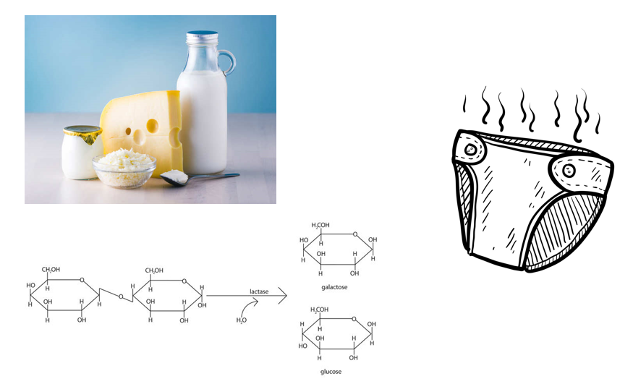
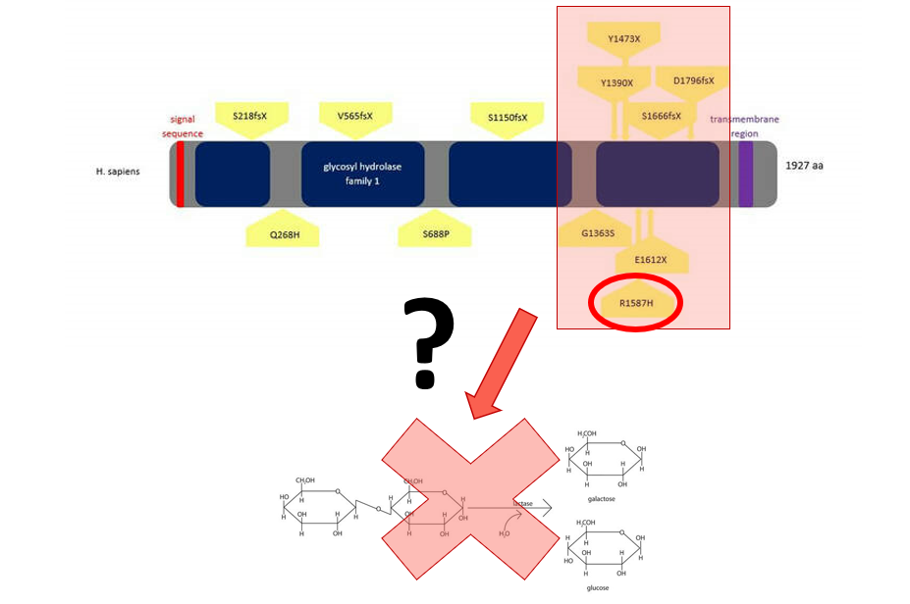
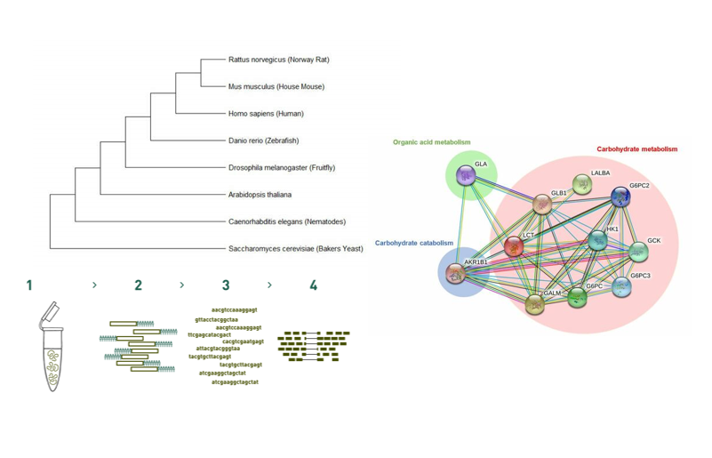
Summary
CLD is a disease caused by lack of lactase (LCT) functional enzyme resulting in inability to digest lactose leading to diarrhea
It is unknown how missense mutations in the C-terminal glycosyl-hydrolase family domain lead to CLD
Phylogenomic, transcriptomic, and proteomic techniques will be used to study the functional contribution of R1587H to LCT

Slide 23
References
Genetics Home Reference (2019). Lactose Intolerance. U.S. National Library of Medicine. Retrieved from https://ghr.nlm.nih.gov/condition/lactose-intolerance#genes
Diekmann, L et al. (2015, March). Congenital lactose intolerance is triggered by severe mutations on both alleles of the lactase gene. BMC Gastroenterology. Retrieved from bmcgastroenterol.biomedcentral.com/articles/10.1186/s12876-015-0261-y
Kuokkanen, M. et. al. (2006, February). Mutations in the Translated Region of the Lactase Gene (LCT) Underlie Congenital Lactase Deficiency. American Journal on Human Genetics. Retrieved from https://www.sciencedirect.com/science/article/pii/S0002929707623647
Behrendt, M. et al. (2009, June). Impaired Trafficking and Subcellular Localization of a Mutant Lactase Associated with Congenital Lactase Deficiency. Gastroenterology. Retrieved from https://www.sciencedirect.com/science/article/pii/S0016508509001425
Luo, Y. et al. (1997, February). Mammalian two-hybrid system: a complementary approach to the yeast two-hybrid system. Biotechniques. Retrieved from https://www.ncbi.nlm.nih.gov/pubmed/9043710
*all images hyperlinked

