Slide 1
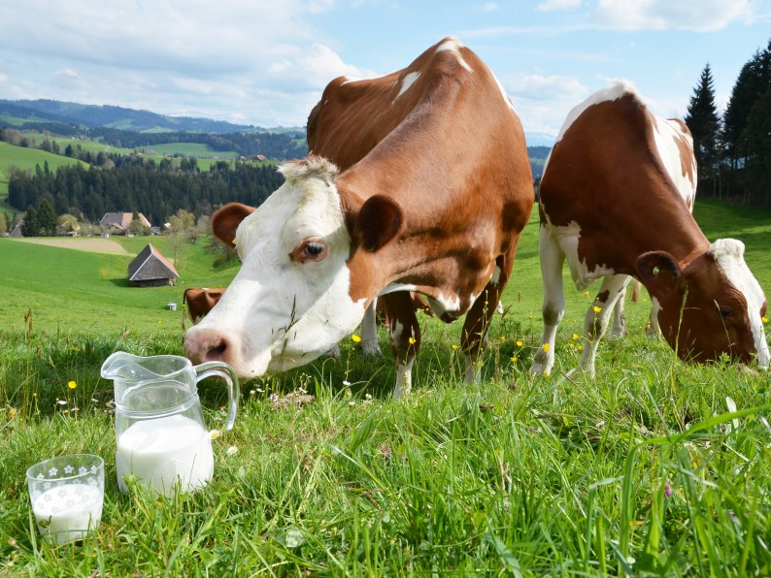
Congenital Lactase Deficiency (LCT)
Hayley Stoneman

Slide 2
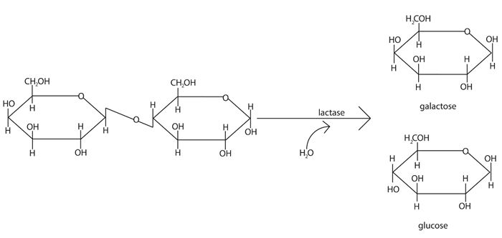
What is congenital lactase deficiency (CLD)?
CLD patients cannot digest lactose, resulting in diarrhea

Slide 3
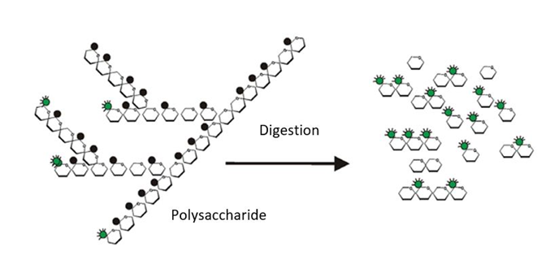
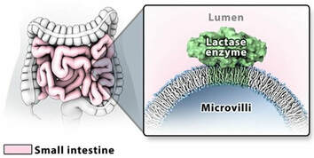
LCT is associated with CLD
Signal sequence
Glycosyl hydrolase family 1
Transmembrane region
Biological Process
Molecular Function
Cellular Component
Polysaccharide digestion
Lactase activity
Intestinal tract

Slide 4
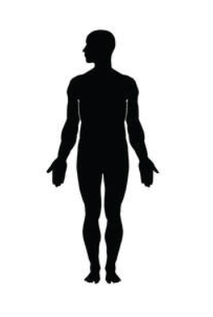
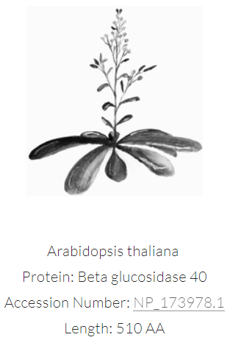
LCT is well conserved in mammals
All homologs have glycosyl-hydrolase family 1 domains

Slide 5
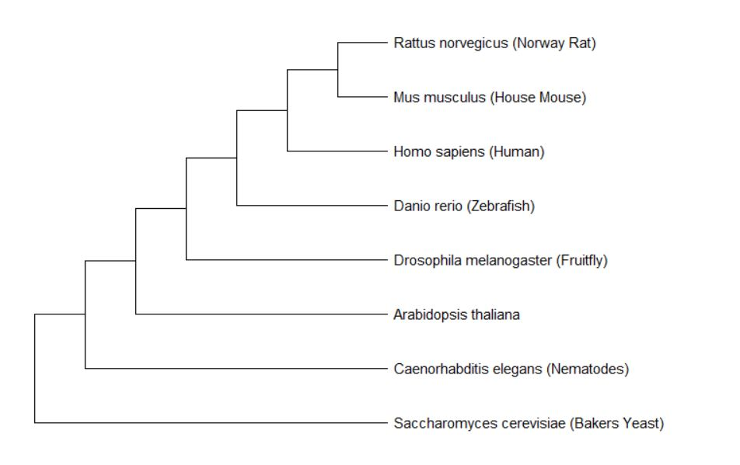
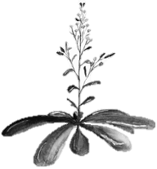
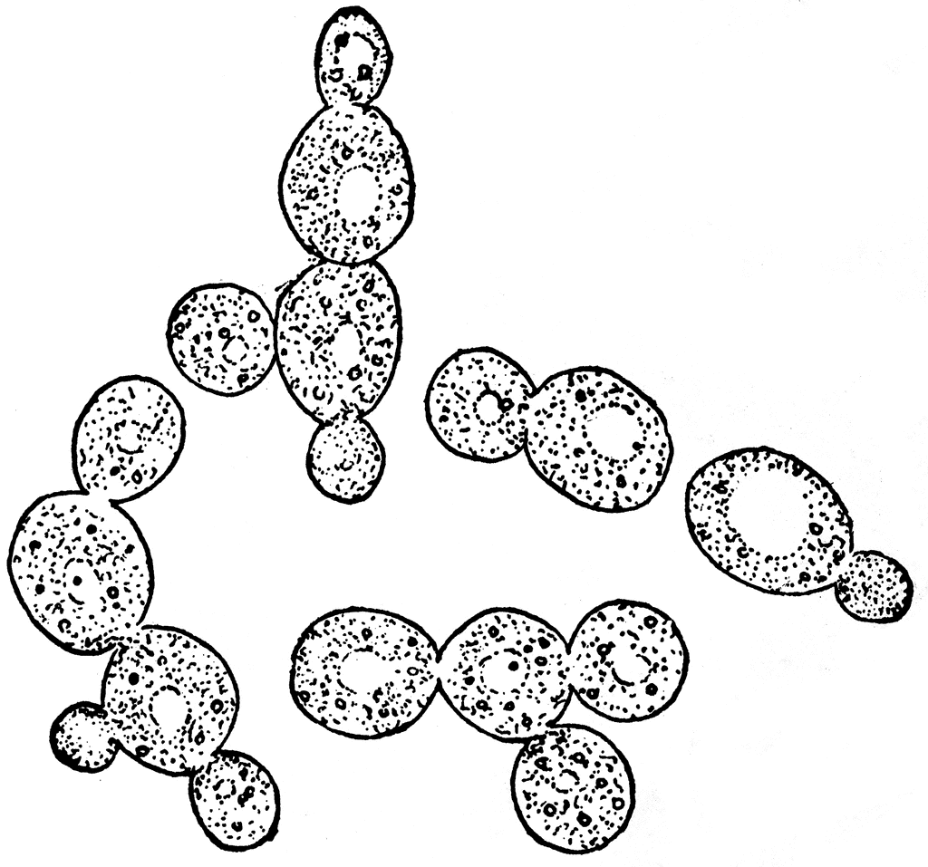
What is LCT phylogeny?
Neighbor Joining Tree
Milk-consuming animals have closest related LCT proteins

Slide 6
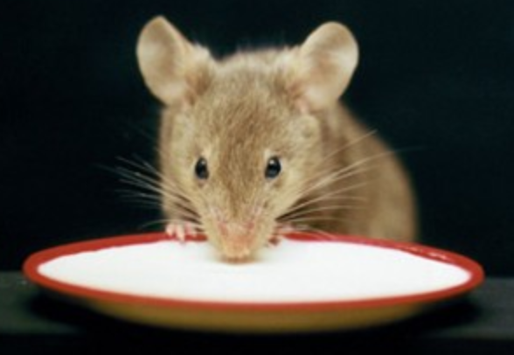
What model organism should be used to study CLD?
Mouse diet is easily manipulated and diarrhea is easily observed

Slide 7
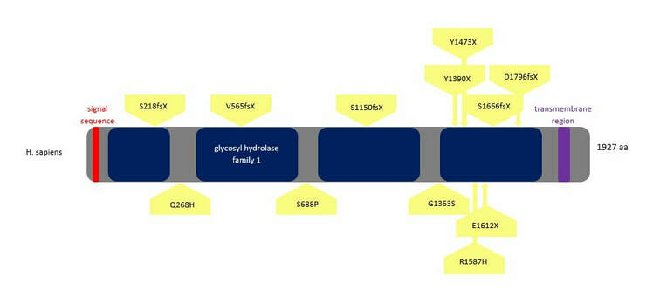
Unknown how R1587H causes loss of functional lactase and CLD
?

Slide 8
What is the primary goal?
To understand how a single amino acid substitution, R1587H, affects the structure, function, and interaction of LCT to determine how it leads to CLD
Aim 1
Understand the evolutionary history of LCT and conservation of the C-terminus and R1587
Aim 2
Determine differentially expressed genes and their functions in WT and R1587H mutant mice
Aim 3
Experimentally determine protein-protein interactions of WT and R1587H mutant mice LCT

Slide 9
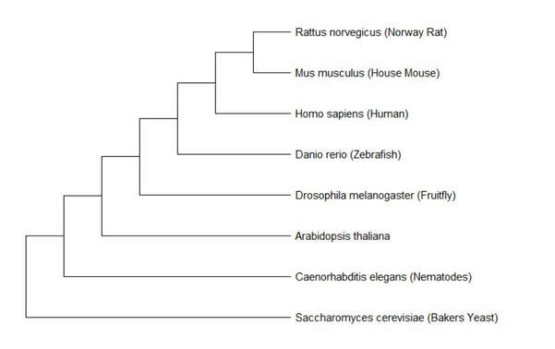
Aim 1: Understand evolutionary history of LCT and conservation of R1587 and the C-terminus
What
Why
Hypothesis
Approach: Use amino acid sequence to build phylogenetic trees and observe conserved regions

Slide 10
Aim 1: Understand evolutionary history of LCT and conservation of R1587 and the C-terminus
What
Why
Hypothesis
?
Rationale: Evolutionary history can elucidate the importance of R1587 in functional lactase among milk consuming organisms

Slide 11
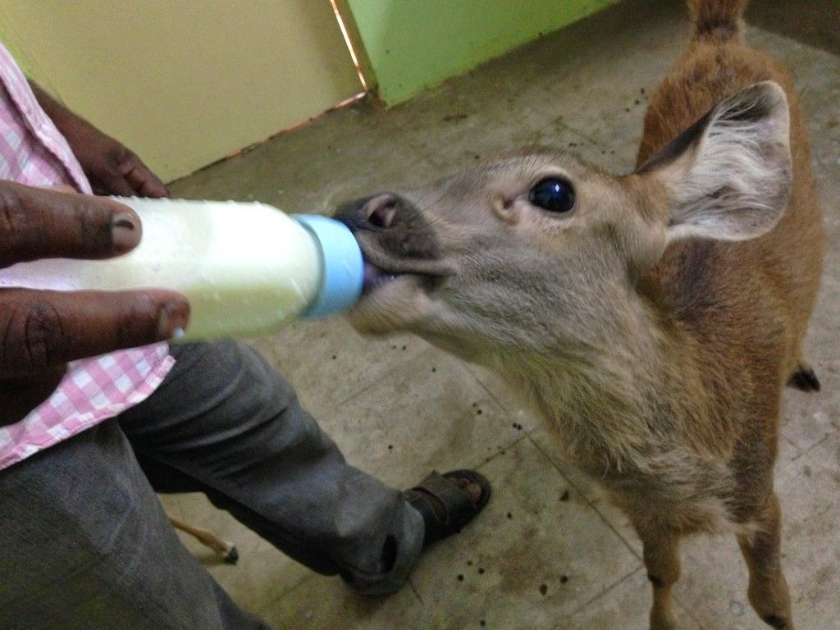
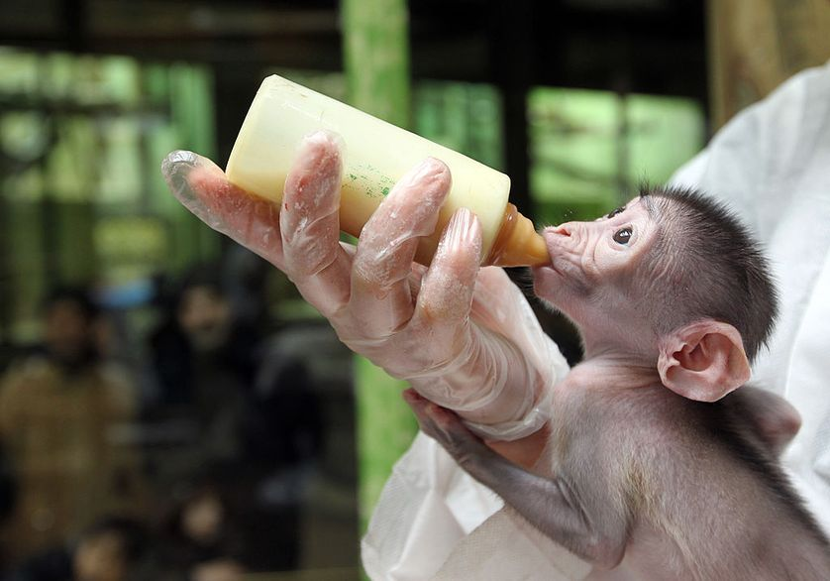
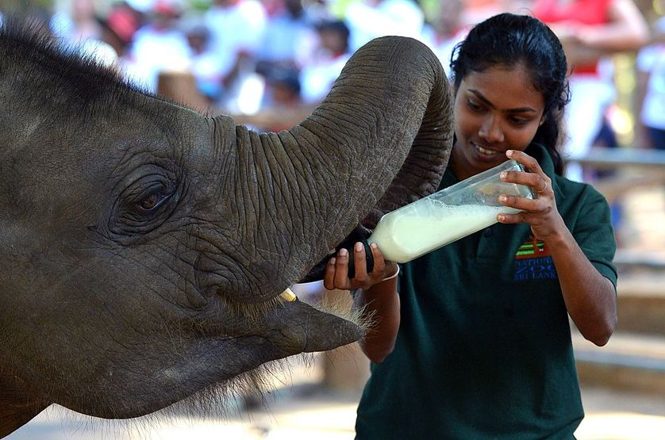
Aim 1: Understand evolutionary history of LCT and conservation of R1587 and the C-terminus
What
Why
Hypothesis
Hypothesis: R1587 will be conserved among milk consuming organisms

Slide 12
Aim 2: Determine differentially expressed genes and their functions in R1587H and WT mice
What
Why
Hypothesis
R1587H
Diarrhea
Approach: Create mutant mouse line and confirm CLD phenotype, then perform RNA-seq to identify gene expression

Slide 13
Aim 2: Determine differentially expressed genes and their functions in R1587H and WT mice
What
Why
Hypothesis
?
Rationale: Determining differentially expressed genes will elucidate interrupted biological processes

Slide 14
Aim 2: Determine differentially expressed genes and their functions in R1587H and WT mice
What
Why
Hypothesis
R1587H
Excretory function
Polysaccharide digestion
Polysaccharide transport
Hypothesis: R1587H mice will have upregulated genes related to excretory function downregulated genes in polysaccharide digestion/transport

Slide 15
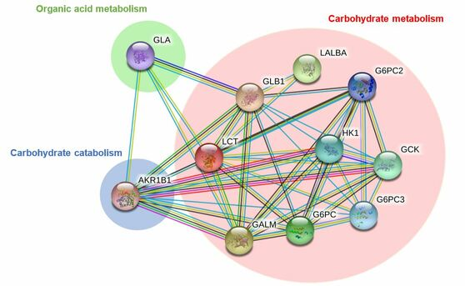
Aim 3: Experimentally determine protein-protein interactions of WT and R1587H LCT
What
Why
Hypothesis
gene
Approach: Use mammalian two-hybrid system to identify protein-protein interactions and sort according to GO terms

Slide 16
Aim 3: Experimentally determine protein-protein interactions of WT and R1587H LCT
What
Why
Hypothesis
?
Rationale: Create first experimentally determined interaction network for LCT and determine which protein-protein interactions inhibited by R1587H

Slide 17
Aim 3: Experimentally determine protein-protein interactions of WT and R1587H LCT
What
Why
Hypothesis
Hypothesis: Interaction network will involve carbohydrate metabolism proteins and R1587H will interrupt many of these interactions

Slide 18
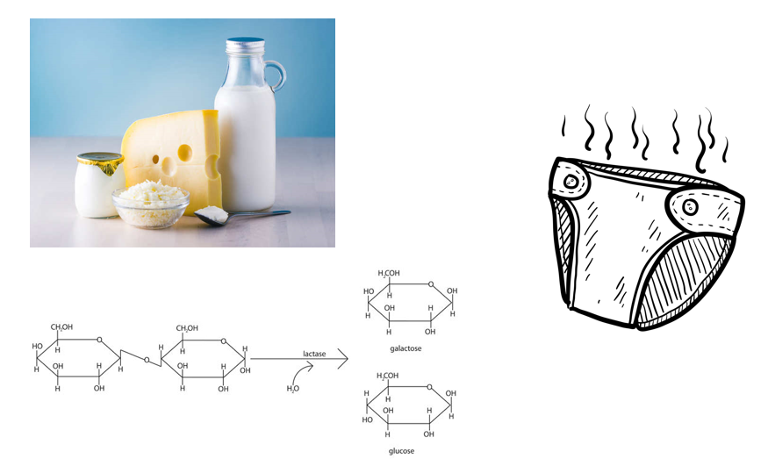
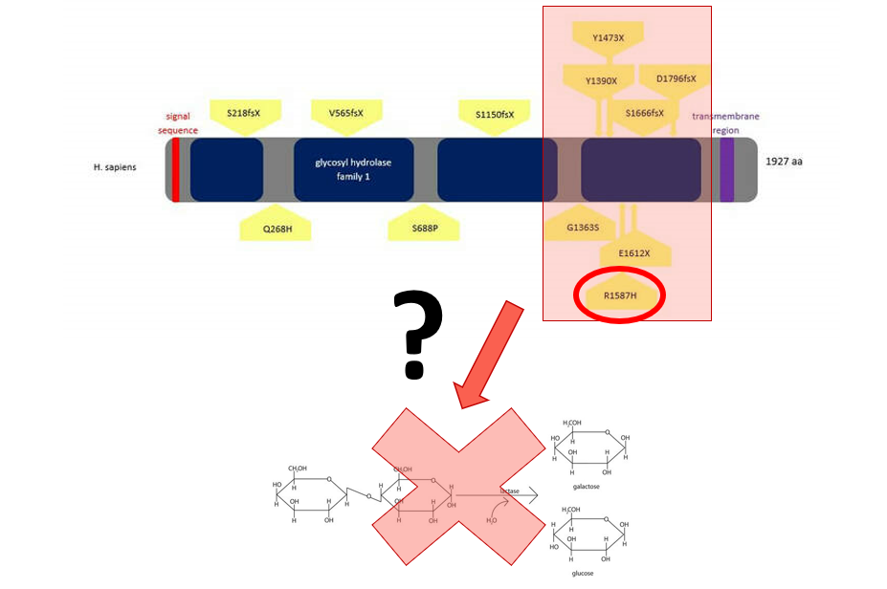
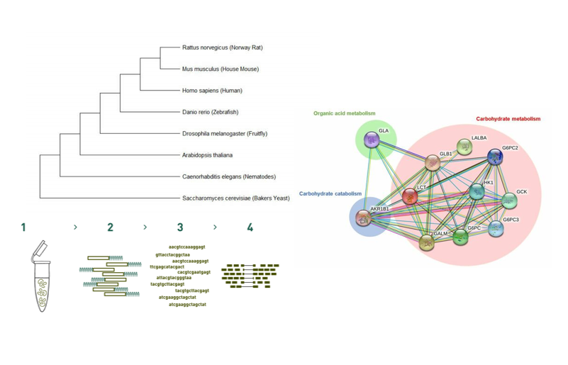
Summary
CLD is a disease caused by lack of lactase (LCT) functional enzyme resulting in inability to digest lactose leading to diarrhea
It is unknown how missense mutations in the C-terminal glycosyl-hydrolase family domain lead to CLD
Phylogenomic, transcriptomic, and proteomic techniques will be used to study the functional contribution of R1587H to LCT

Slide 19
Future Directions
Develop treatment for CLD

Slide 20
Questions?

Slide 21
References
Genetics Home Reference (2019). Lactose Intolerance. U.S. National Library of Medicine. Retrieved from https://ghr.nlm.nih.gov/condition/lactose-intolerance#genes
Diekmann, L et al. (2015, March). Congenital lactose intolerance is triggered by severe mutations on both alleles of the lactase gene. BMC Gastroenterology. Retrieved from bmcgastroenterol.biomedcentral.com/articles/10.1186/s12876-015-0261-y
Kuokkanen, M. et. al. (2006, February). Mutations in the Translated Region of the Lactase Gene (LCT) Underlie Congenital Lactase Deficiency. American Journal on Human Genetics. Retrieved from https://www.sciencedirect.com/science/article/pii/S0002929707623647
Behrendt, M. et al. (2009, June). Impaired Trafficking and Subcellular Localization of a Mutant Lactase Associated with Congenital Lactase Deficiency. Gastroenterology. Retrieved from https://www.sciencedirect.com/science/article/pii/S0016508509001425
Luo, Y. et al. (1997, February). Mammalian two-hybrid system: a complementary approach to the yeast two-hybrid system. Biotechniques. Retrieved from https://www.ncbi.nlm.nih.gov/pubmed/9043710
*all images hyperlinked

